Slide 1

ZIGBEE
Farbod Yadollahi
Aliasghar Pourghani
Saba Nasiri

Slide 2
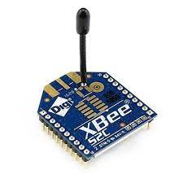
Overview
Low-cost
Low-power
IEEE 802.15.4 based
Radio frequency: 2.4 GHz
Data rate: 20-250 kb/s
Zigbee Module

Slide 3
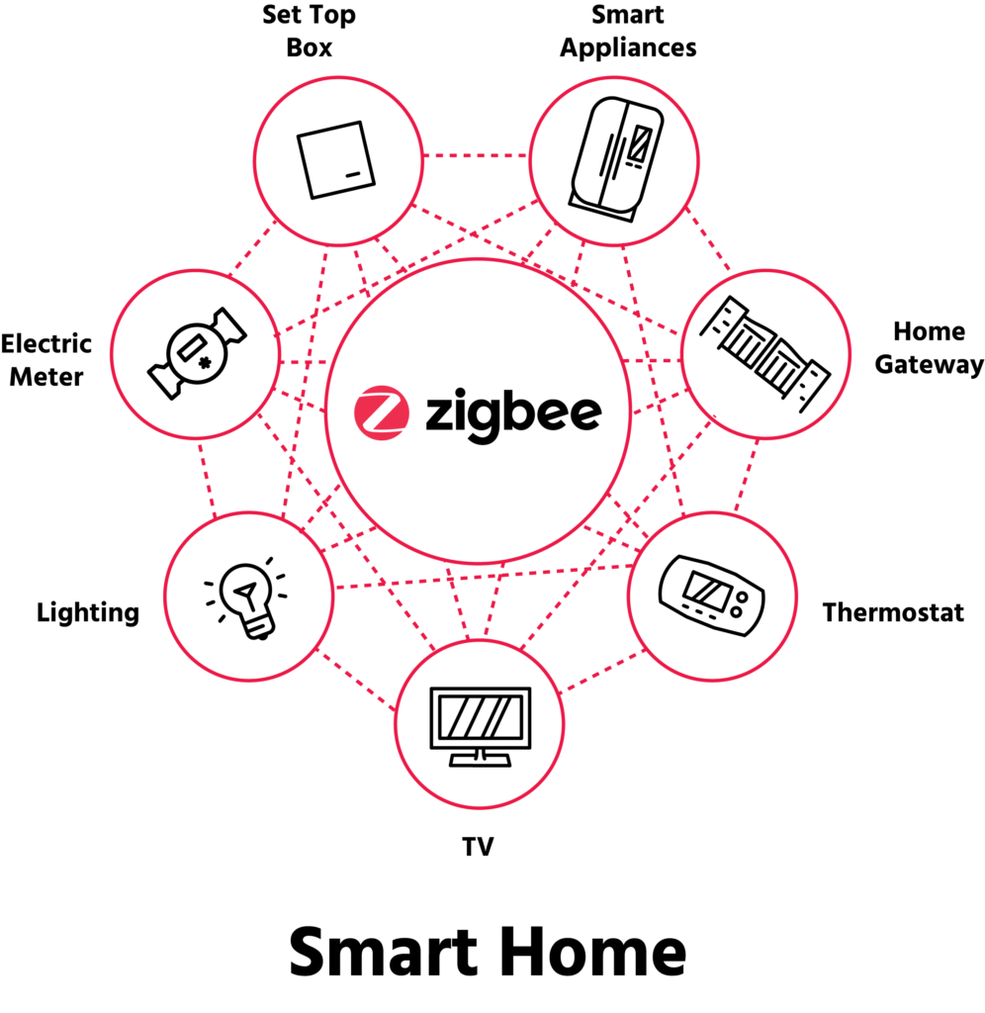
Use cases
Home Automation
Wireless sensor networks(WSN)
Medical data collection
Industrial control system
Smoke and intruder warning
Not used in cases with high mobility and ad-hoc networks!

Slide 4
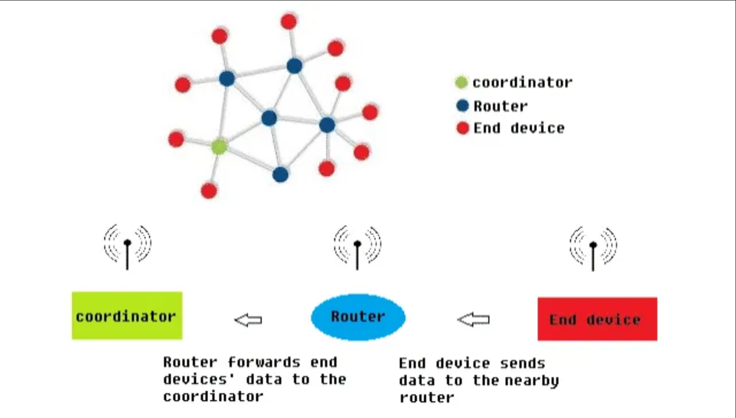
Zigbee Device types
Zigbee coordinator(ZC): the most capable device
Zigbee router(ZR): passes data from connected devices, extends coverage
Zigbee end device(ZED): low-cost, high battery life, can sleep most of the times

Slide 5
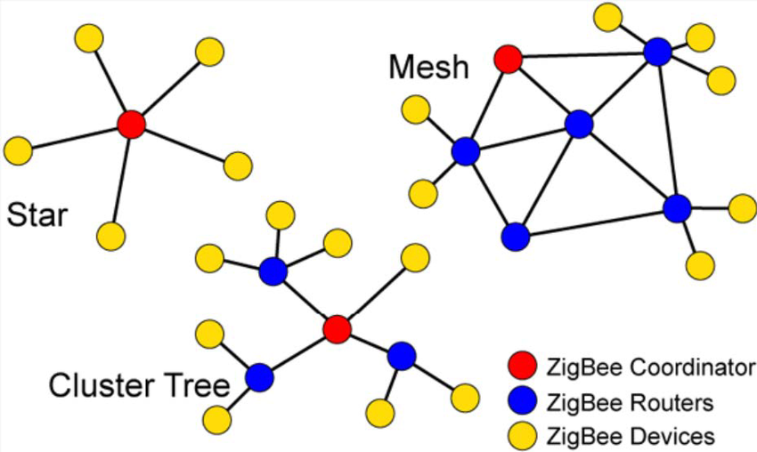
Zigbee Network Topologies
Star
Mesh
Cluster Tree

Slide 6
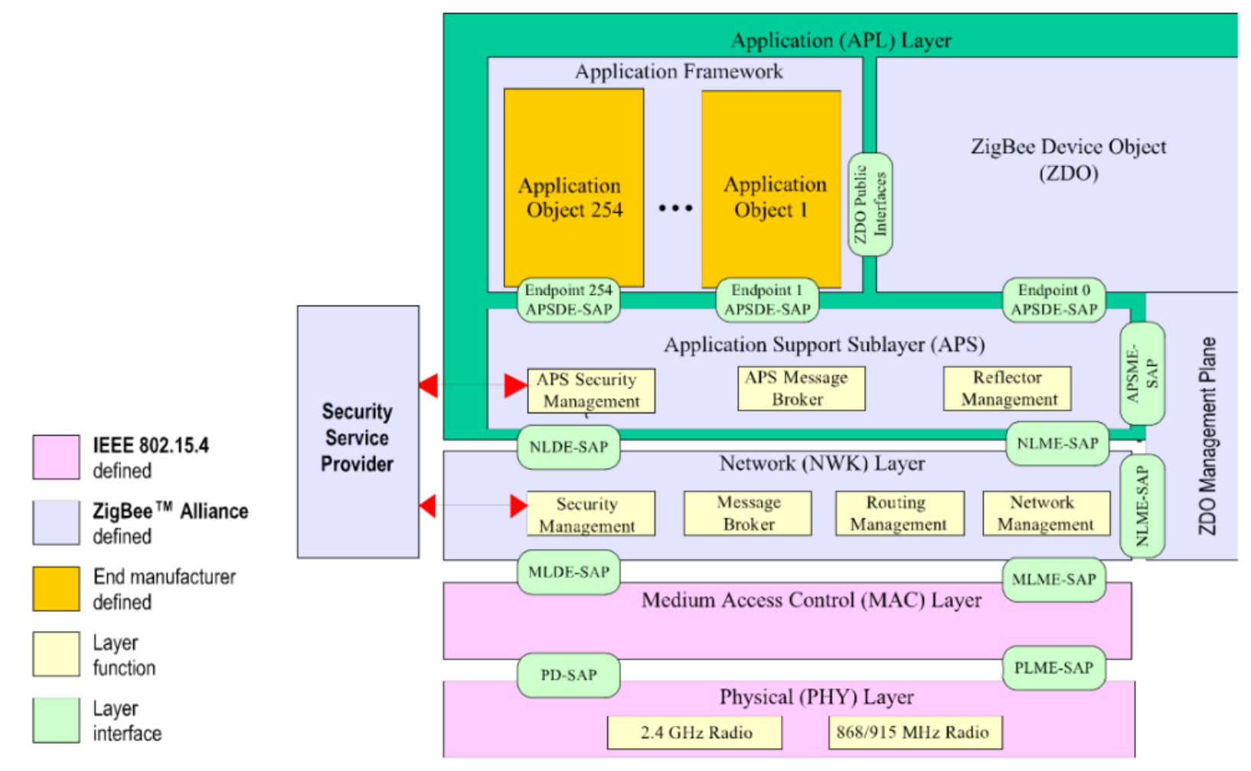
Zigbee Protocol Stack
Physical and MAC layer
(IEEE 802.15.4)

Slide 7
Zigbee Protocol Stack
Network Layer

Slide 8
Zigbee Protocol Stack
Application Layer

